Slide 1
ER IPT HACK_2023
Track 2: Calculations
YAV-SSV Team Approach

Slide 2


Slide 3



Task
The focus is on resource-intensive tasks performed by CERN for processing Large Hadron Collider experiment results.
Investigate measurement the performance of these computational tasks.
Investigate measurement of energy efficiency of these computational tasks

Slide 4

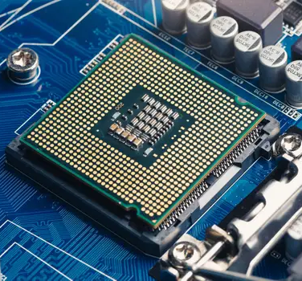
Overview -
Energy Consumption Measurement
Intel RAPL
Powerstat
PowerTOP
perf
Likwid
Software provides access to the measurements
CPU consumes energy
OS reads sensors

Slide 5

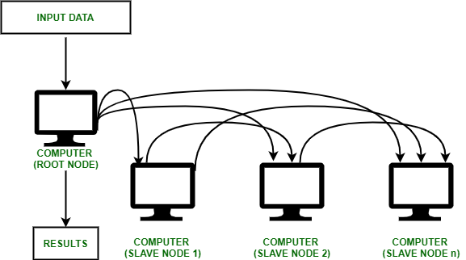
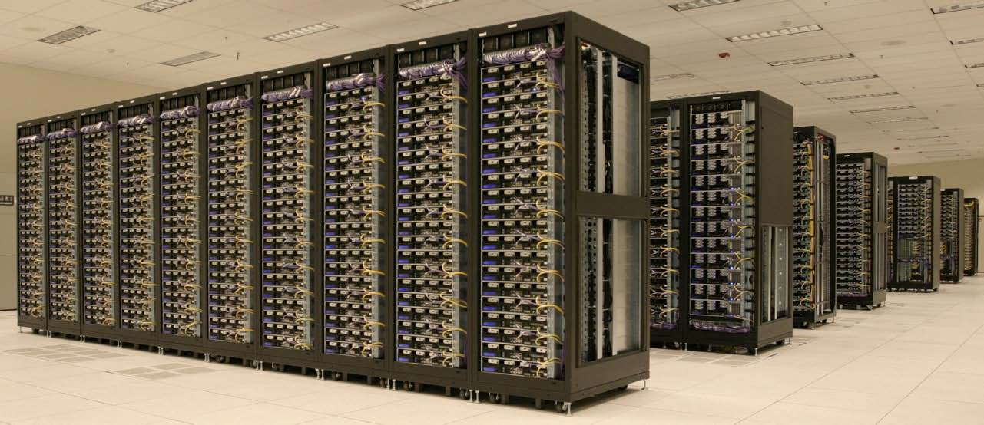
Overview - WLCG
global collaboration of around 170 computing centres
more than 40 countries
distribute and analyse the ~200 Petabytes of data from Large Hadron Collider every year
More: wlcg.web.cern.ch

Slide 6

Overview - WLCG Workload
HEP Benchmark Suite
gitlab.cern.ch/hep-benchmarks/hep-benchmark-suite
Benchmarking
Run workloads representative of the production applications running on WLCG
Enable performance studies on heterogeneous hardware
Production
Madgraph5_aMC@NLO
Madgraph4gpu
github.com/mg5amcnlo
github.com/madgraph5
Hardware

Slide 7
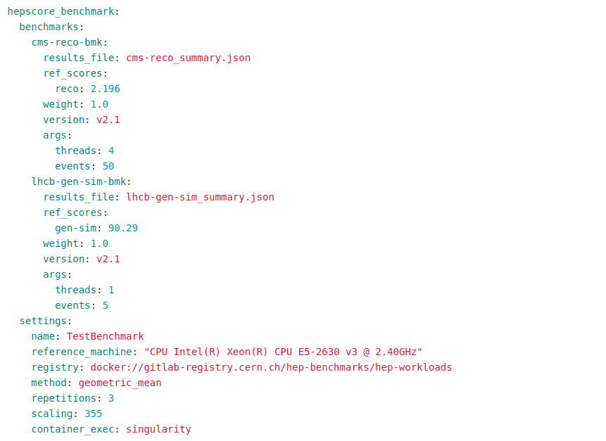
HEPScore Benchmark
Replacement of proprietary HS06
Consists of several CPU-intensive workloads
Executes workload in containers (Singularity/Docker)
Each workload score is normalised to the score of the reference server, in order to make it a dimensionless factor
More info:
Source code repository
HEPScore the HEP-specific benchmark

Slide 8
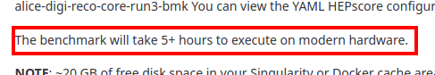










Challenges
Slow computation
Hardware dependence - inability to parallelize tests, not obvious comparison between CPU and GPU
Unsterility of the environment
Limited use of VM due to lack of access to the physical CPU
HEPScore

Slide 9
Experiment workflow
Setup:
Stick to a single benchmark task (belle2-gen-sim-reco-bmk)
Run locally (AMD Ryzen 5 5500U, 6 cores, 12 threads)
Linux, perf (power/energy-pkg), cpupower, docker
Workflow:
Limit upper CPU frequency
Run perf and benchmark workload
Save results
Repeat few times
For each available cpu frequency (1.4 GHz, 1.7 GHz, 2.1 GHz)

Slide 10
Results
 | 1.4 GHz | 1.7 GHz | 2.1 GHz
Power consumption median, Joules | 5927.65 | 5468.11 | 6267.85
Power consumption max, Joules | 6023.65 | 5492.29 | 6960.44
Power consumption min, Joules | 5907.67 | 5427.24 | 6210.68
Benchmark score median | 85.697 | 102.808 | 138.308
Benchmark score max | 85.7325 | 103.163 | 142.1775
Benchmark score min | 85.2355 | 102.6305 | 136.533
Execution time median, s | 688.5928424 | 569.9492953 | 417.5034929
Execution time max, s | 690.952235 | 570.8386744 | 420.9916446
Execution time min, s | 685.7868938 | 568.2845271 | 394.5543055
Score per joule median | 0.014463152 | 0.018856345 | 0.021958646
Score per joule max | 0.014506057 | 0.018910256 | 0.022269381
Score per joule min | 0.014150142 | 0.018740637 | 0.02042651
5 runs for each frequency

Slide 11
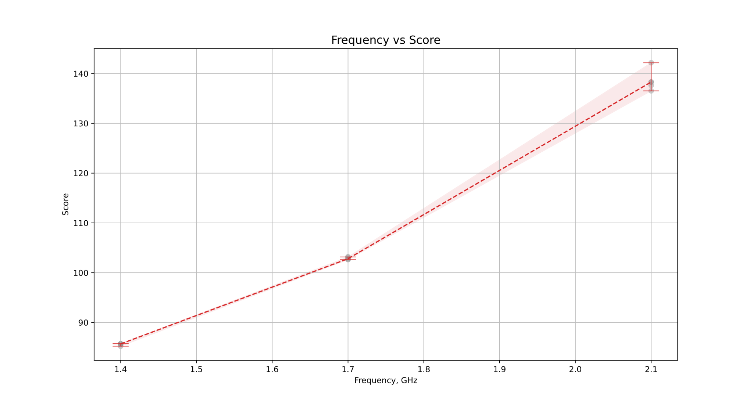
Results

Slide 12
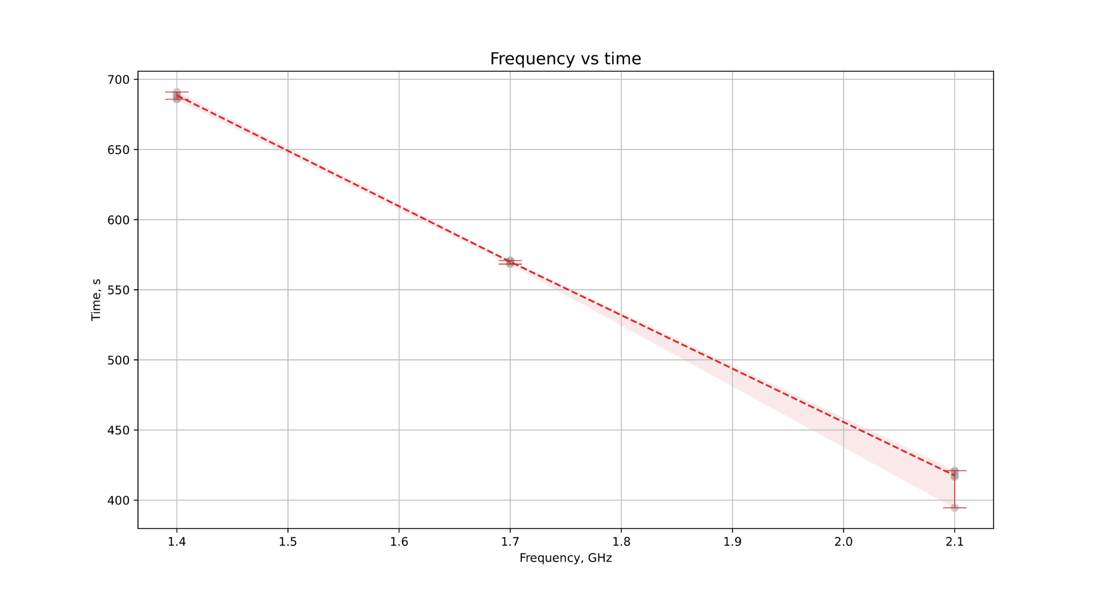
Results

Slide 13
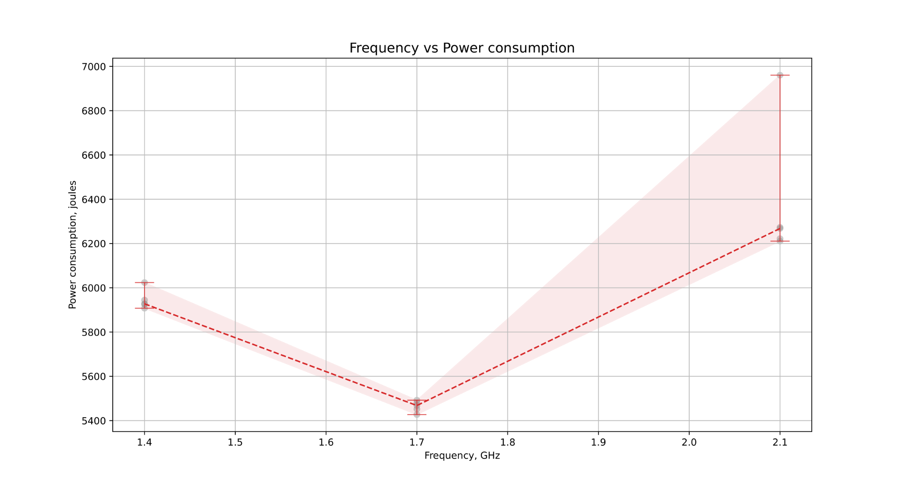
Results

Slide 14
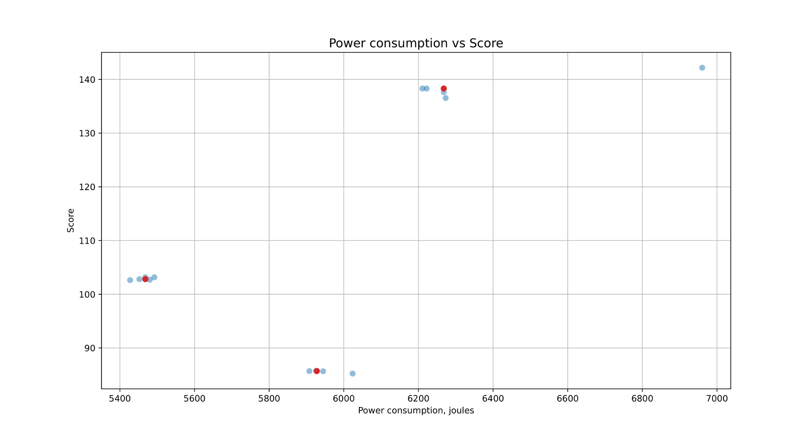
Results

Slide 15
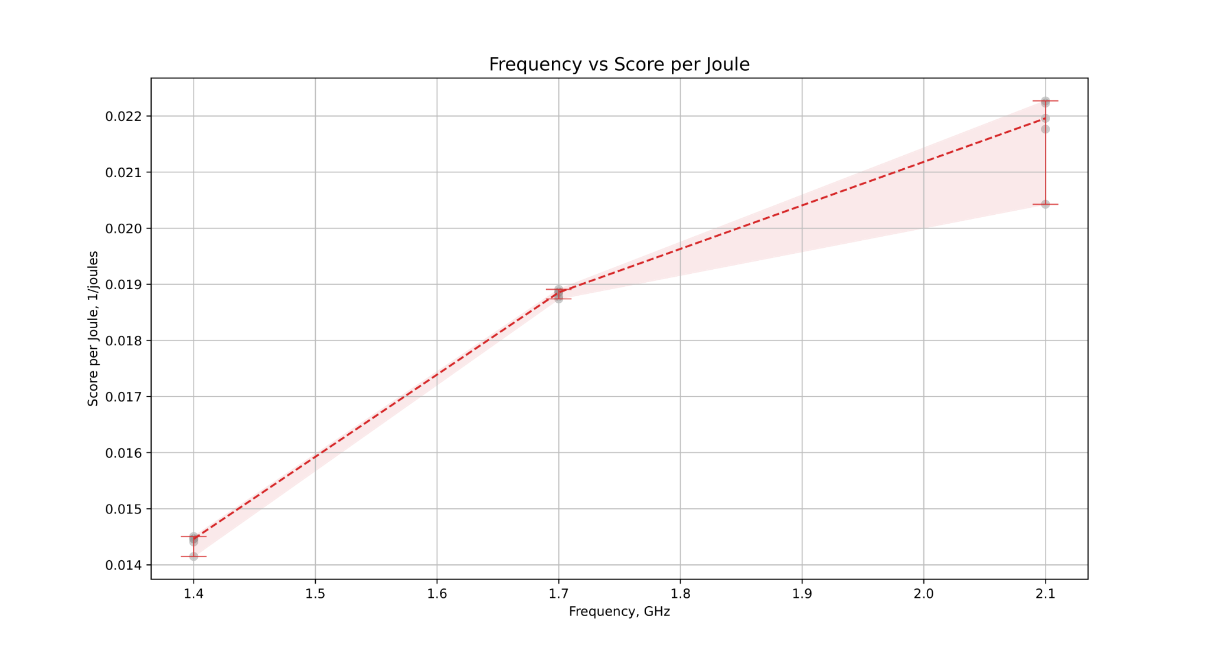
Results

Slide 16
Summary
Limiting the CPU frequency reduces power consumption, until a certain point
Performance and execution time changes monotonically depending on the frequency
Score to Energy consumption ratio also decreases with limiting the frequency, which means there is more performance loss than energy efficiency gain
There is no silver bullet: decision making should be careful and and focused on current problems to choose the best trade-off

Slide 17
Experiment 2
Goal: validate measurement of power consumption
Same software setup as in main experiment
The laptop is disconnected from charging
Charge level of battery recorded before and after benchmark run (upower)
Important notice: the laptop battery is not monitored as actively as the CPU (the info is updated only once every 30 seconds, with a certain step of accuracy), so the measurement is approximate.
Results - the ratio of perf’s power consumption measurement to battery discharging (statistics of 3 runs):
 | ratio
frequency | mean | max | min
1.7 GHz | 0.606138015 | 0.668914919 | 0.57420385
2.1 GHz | 0.689998177 | 0.72618657 | 0.67078084

Slide 18
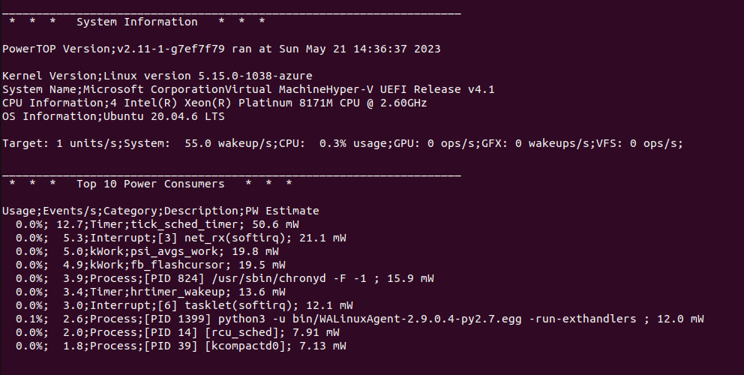

Future Steps
More detailed tests at different frequencies
More comprehensive benchmarking
Detailed metrics for power consumption
Experiments on other platforms (e.g. Cloud VM)
PowerTOP

Slide 19
Source code:
github.com/andrii0yerko/ER-IPT-HACK_2023

Slide 20
Thank for your attention!

